Slide 1
Tiny Encryption Algorithm (TEA) Benchmarking on the Raspberry Pi 3B+
California State Polytechnic University, Pomona
College of Engineering
Department of Electrical and Computer Engineering
Sydney Cady, Ryan Schwartz, Steven Yu, Mohamed El-Hadedy Aly

Slide 2
Tiny Encryption Algorithm
What is TEA?
TEA is a simple block cipher designed by David Wheeler and Roger Needham at the Cambridge Computer Laboratory.
Designed to encrypt and decrypt data for security purposes.
TEA scrambles plaintext based on a key so that it becomes unreadable without the key.
Operates on two 32-bit unsigned integers (one 64-bit data block).
Has a 128-bit key size.
Typically runs 64 Feistel rounds (32 cycles).

Slide 3
Objective
Hardware: Raspberry Pi 3B+
Software: TEA.py, TEA.cpp
Executing the TEA written in Python and the TEA written in C++ on a Raspberry Pi 3B+ to measure and compare their performance metrics.
Gaining a better understanding of basic data encryption and decryption methods.
Performance metrics: CPI, MIPS, execution time, and power consumption

Slide 4
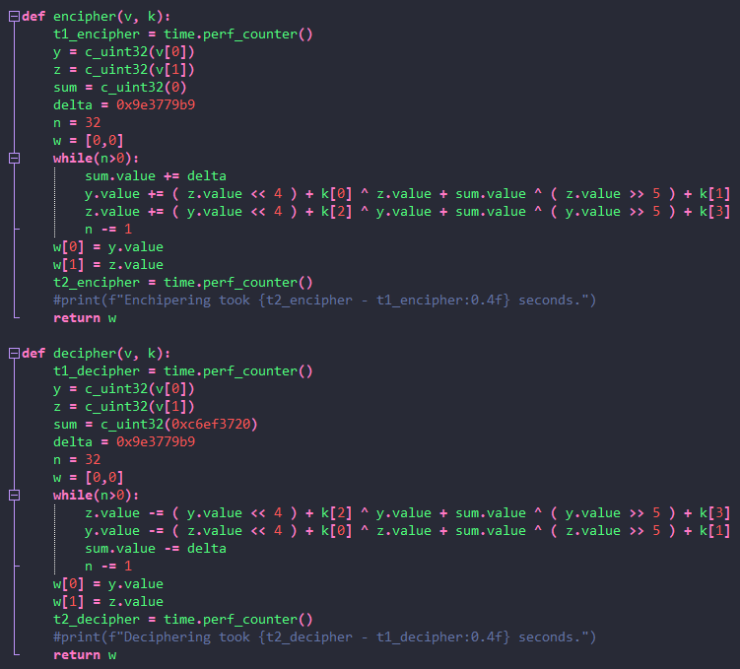
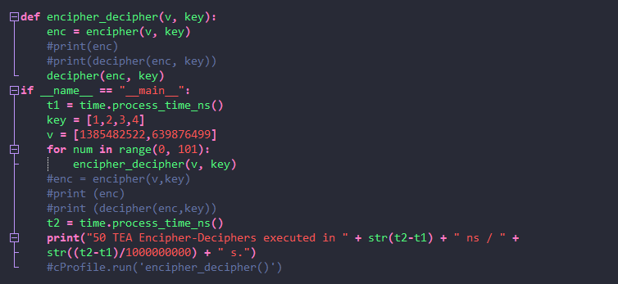
TEA in Python

Slide 5
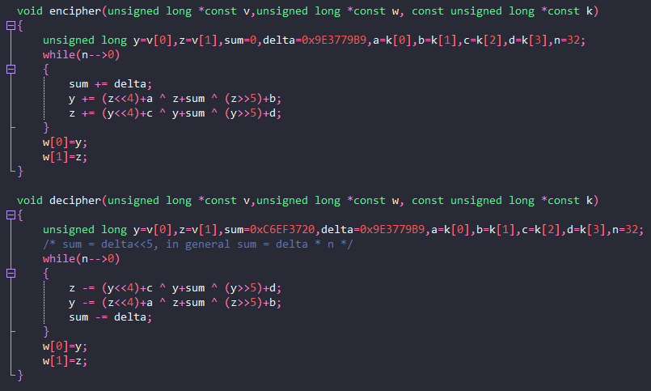
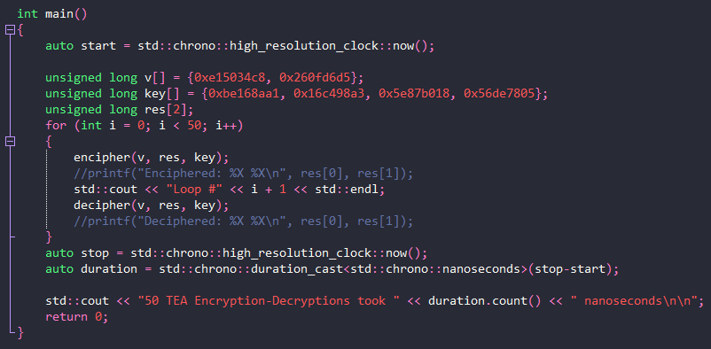
TEA in C++

Slide 6
Code Description
The source code can be divided into a Encipher method, Decipher method, and Main driver program.
The Encipher method accepts a two 32 bit blocks of data and a 128 bit key from the driver program.
The blocks of data are cumulatively summed with the key and a mathematical expression in a 32 cycle loop.
The scrambled data is returned to the driver program.
The Decipher method accepts the scrambled data and the key from the driver.
The enciphering process is reversed with the key and mathematical expression cumulatively subtracted from the blocks of data in a 32 cycle loop.
The original data is acquired and returned to the driver program.

Slide 7
Benchmarking Tools
Source code conversion to assembly for instruction count acquisition.
Python GodBolt Compiler Explorer
C++ GNU GCC compiler
Time manipulation libraries for inserting timing devices into the source code.
Python Time module
C++ Chrono library
Power consumption measurement device.
USB power meter

Slide 8
Performance Results
50 encryption-decryption pairs were executed and timed for the entire duration of each benchmark. The following results are based on an average per-pair execution time.
Performance Metric | Python | C++
Assembly instruction count | 387 | 687
Execution time | 1.6983771 ms | 0.145586 ms
CPU clock cycles | 2038.13 | 174.71
CPI | 5.26629 | 0.254299
MIPS | 0.227865 | 4.71886

Slide 9
Performance Analysis
TEA in C++ runs approximately 11.7 times faster than in Python (C++ 1.6983771 ms vs. Python 0.145586 ms) on a Raspberry Pi 3B+.
CPI and MIPS data shows that C++ is more efficient at cycling the instructions than Python.

Slide 10
Power Results

Slide 11
Power Analysis

Slide 12
Amdahl’s Law: XTEA vs. TEA

Slide 13
Resources
Python TEA implementation, stack overflow, https://stackoverflow.com/questions/2588364/python-tea-implementation
David Wheeler and Roger Needham, “The Tiny Encryption Algorithm (TEA)”, Cambridge Computer Laboratory
Python to assembly, Compiler Explorer, https://godbolt.org/
Convert C/C++ code to assembly language, GeeksforGeeks, https://www.geeksforgeeks.org/convert-cc-code-to-assembly-language/

